Slide 1
Descartes Core (DesC) Vision & VoCamp Strategy
Similar to Dublin Core for the library science and Darwin Core
for ecology (but will be “better”)
Early Descartes-Core work at 2013/2014 meetings.

Slide 2
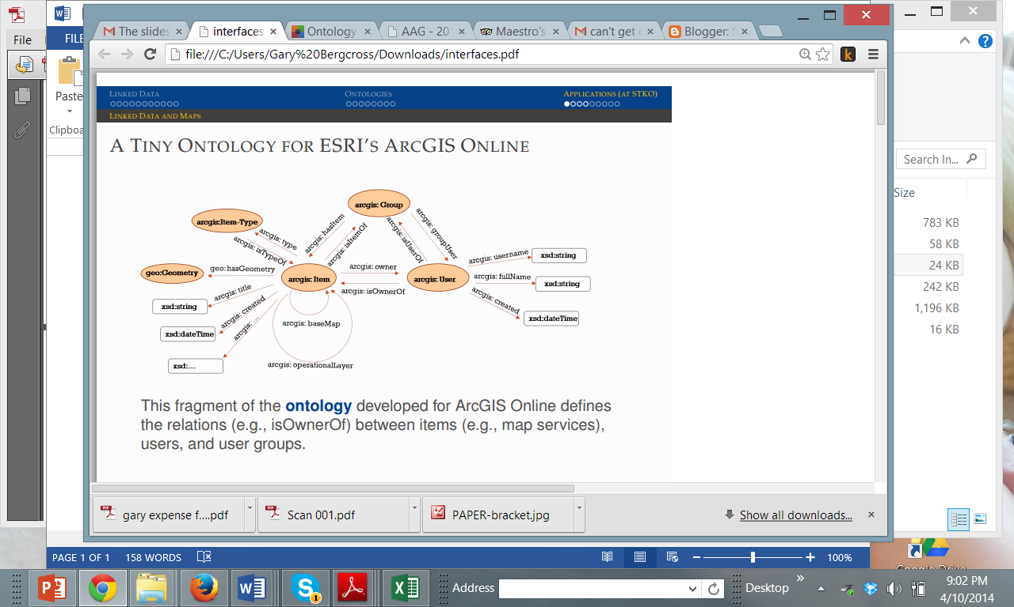
Goals- Build on Past Workshops, Interests, Experience as part of a Broader Descartes-Core Vision
DesC is NOT a top-level ontology but a related group of
(geo-)ontology design patterns,
micro-ontologies (ArcGIS example),
best practice guides,
examples,
software, and services.
Designed to foster semantic interoperability between
different (Linked Data) sources without simultaneously restricting real semantic heterogeneity.
After Krzysztof Janowicz at DC VoCamp 2013
See: http://bit.ly/19y5dk0

Slide 3
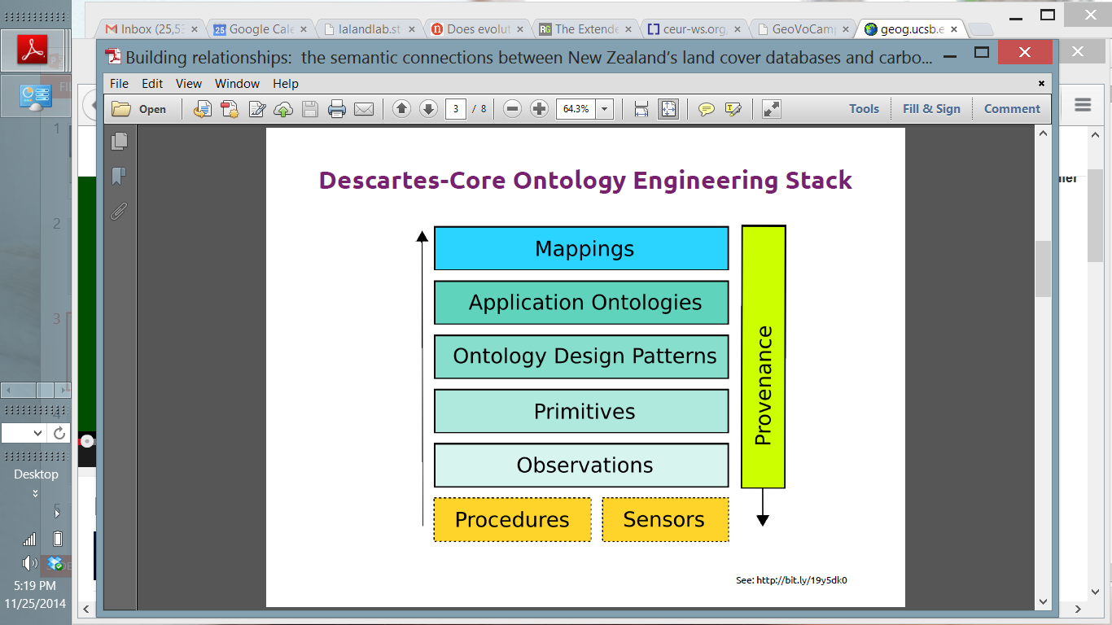
Krzysztof Puts the ideas together: Observation-Driven Geo-Ontology Engineering (ODOE)
Understanding
Local
Push
MetaData
Best practice guides
Examples
Develop
Data
Some Progress
Observation-driven framework to the engineering of geo-ontologies (ODOE) that can be integrated with existing methodologies
Sign up to be part of a group to help develop any of these....
Notes:
Jano

Slide 4
Life Cycle
Assessment
Start on a microtheory?
Setting
Theme
Spatial
Time
Geometry
GeoSPARQL
Material
Transformation
Surface
Networks
Contour
Boundary
Event
Surface
Water
Cartographic Symbology
Motion
Transport
Path
GeoVoID
Point of Interest
Semantic
Trajectory
Containment
Start on a microtheory?
Refined for application?
CityML
University
Building
4

Slide 5
Illustrating Methods using a Sample Topic
Describe Samples using standard languages & vocabularies

Slide 6
Outline
Models provide an overview start and entry into relevant literature and work
Many views of (Physical) Sample and associated vocabularies
Conflicting models and heterogeneous vocabularies makes integration difficult
Real data from observations organized into science domain scenarios can help
Bottom driven from scenario, existing vocabularies & published data etc.
Extracting Propositions & Fact Statements
What vocabularies exist?
Building a Conceptual Model
Organize into Middle view from existing schema, larger ontologies & relevant ODPs
Top-down addition from organizing ontologies
Relevant ODPs

Slide 7
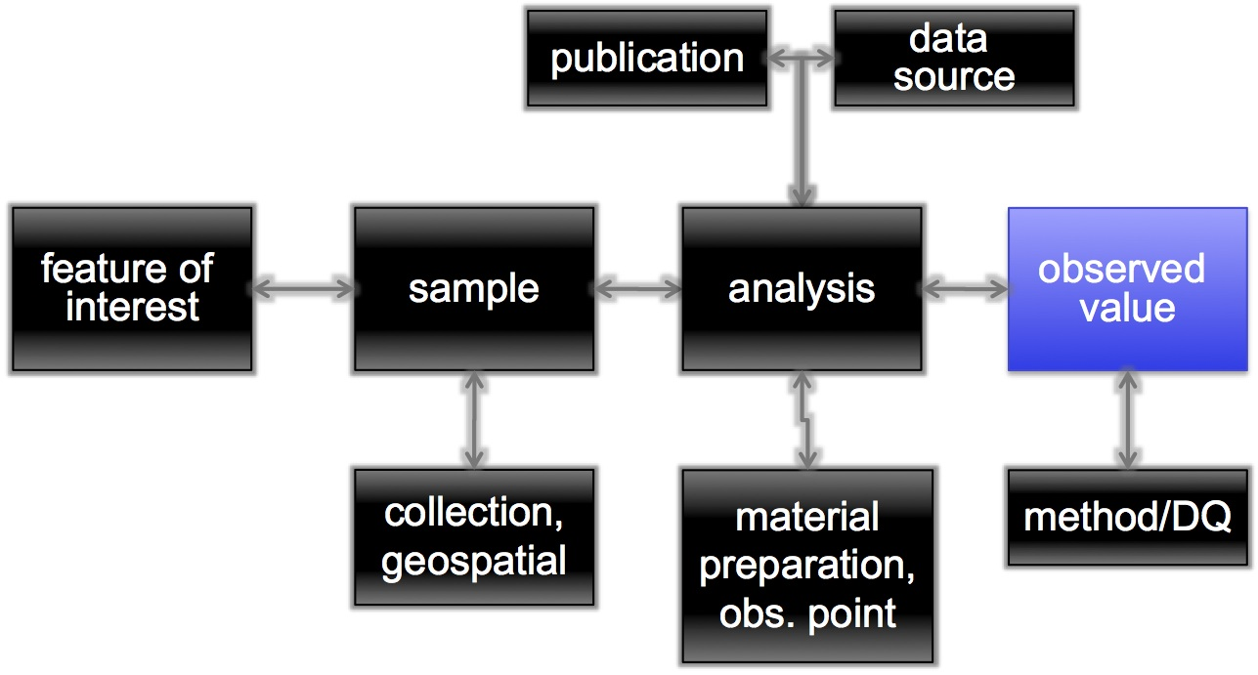
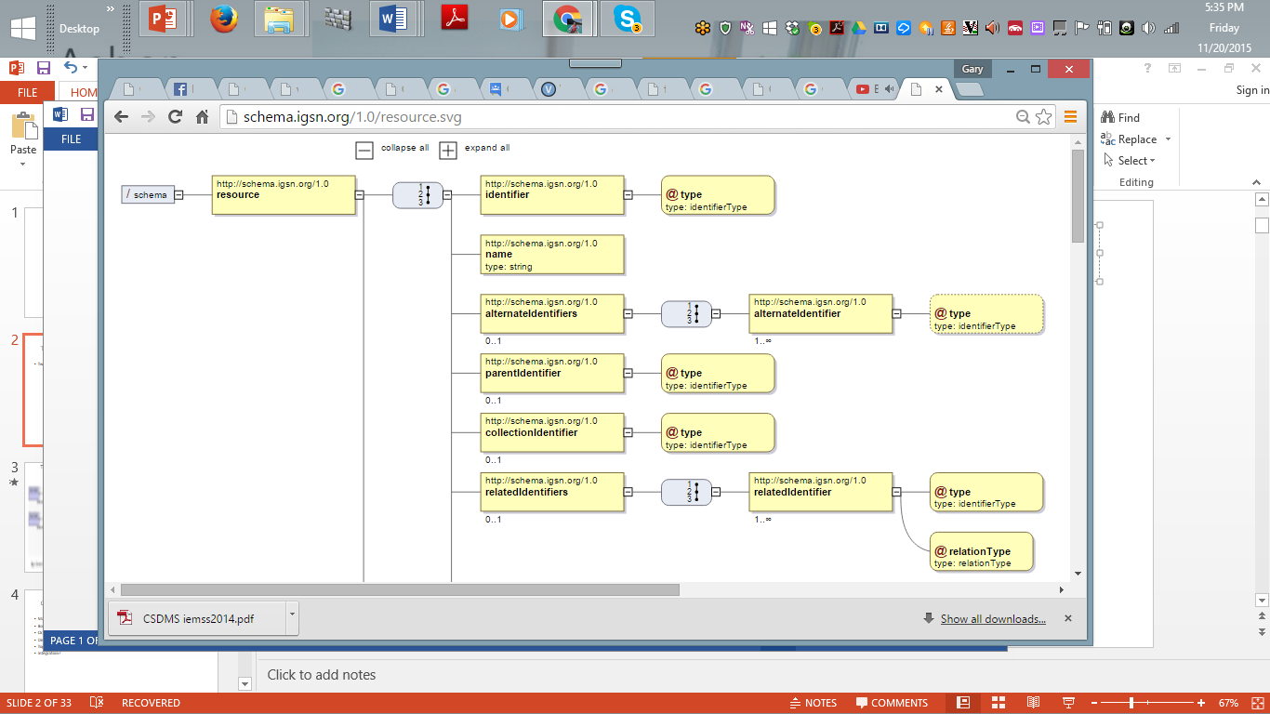
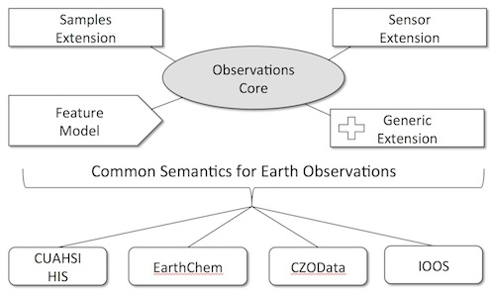
IGSN
International Geo Sample Number Birth Record

Slide 8
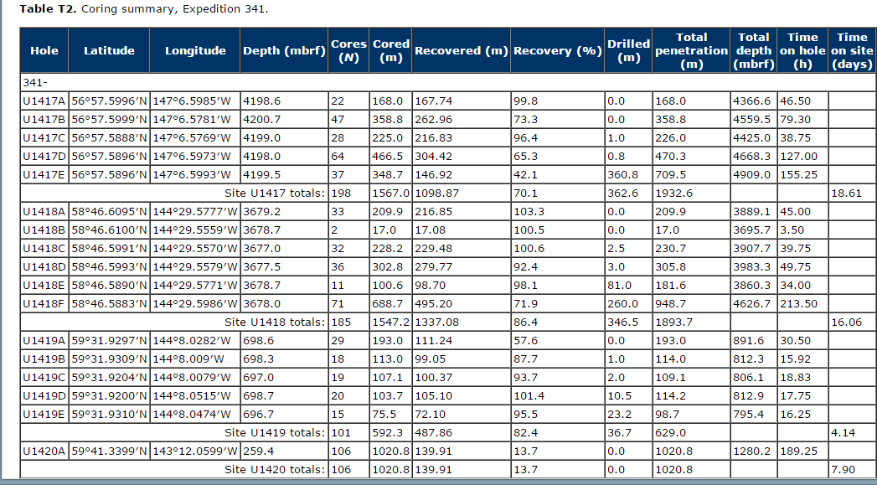

Slide 9
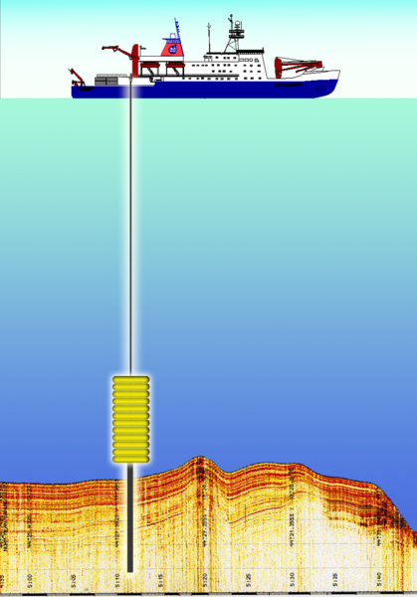
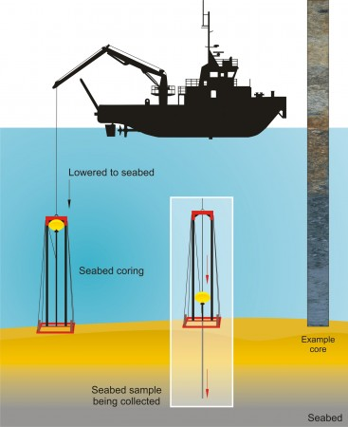
Illustration: drilling site U1417 in the Gulf of Alaska on June 4, 2013.
Agent
(collector Role)
Collects at Time T on 6/4/2013
Instrument: Vibrocorer
2+- Core Samples
2-100+ subsamples
Medium: Sediment
Constituents: various types includes biota (eg shells, pollen, plants, insects & minute animals) from the overlying ocean water, eroded material from land (eg. , bits of wood ) transported rivers or wind, Inorganic sediments such as ash or volcanic glass from volcanoes, and chemical precipitates
Sampling Method:
(piston)
After: http://publications.iodp.org/preliminary_report/341/341_11.htm & http://publications.iodp.org/preliminary_report/341/341_f6.htm
Sampling Site
(has location &
Geometry)
Constituent Features:
sediment grain size, type of sediment, color of sediment,
age of pollen etc.

Slide 10
Some possible propositions
Agent Amy S collected Sample IGSN:WHO000BC7
Agent Amy S assigns Sample ID
Sample has ID IGSN:WHO000BC7
sem:hasTimeStamp subtype hascollectTimeStamp
Sample hascollectionTimeStamp 13:02:on 6/4/2013
Sample hasMedium Seafloor Sediment
Sample collectionMethod CoringMethod
CoringMethod usesInstrument Vibrocorer
Sample hascollectionSite Site U1417
Site U1417 hasSiteType coastal
Site U1417 hasFeatureofInterest Hole U1417A
Hole U1417A has hasFeatureofInterestType Hole
Hole U1417A hasDrillDepth DrillDepthValue 168.0 meters
Hole U1417A hasLongitude 147°6.5985′W
Hole U1417A hasLatitude 56°57.5996′N
Agent participates RecordCreationEvent
RecordCreationEvent creates SampleRecord
SampleRecord has material information bearerType information content entity
Etc....

Slide 11
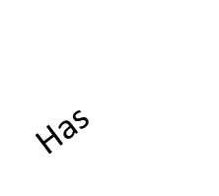
High-level View of Sample and Related Conceptual Pattern Based on the Propositions
Material information bearer
Record Creation event
Time
Actor
Participant
Participant
Place
createsRecord
Sampling Obs event
Sample
SubType
sem:hasPlace
hasRecord
SamplingEvent
Record
Has
Participant
Produces
hasPart
hasLongitude Record
Attributes 6.5985′W
Dwc:hasdecimalLongitude
Sampling process
Sub-Sample
hasLongitude 147°6.5985′W 6.5985′W
Uses
Leverages Participant, Information (Information artifact ontology (IAO)) & Simple Event Model (types of event, actor place, & time)
Instrument
Sampling Method
Uses
Notes:
SamplingEvent has Place and Sample wasCollectedAt (ODM2).
There are atmospheric & oceanic process and geothermal ones too

Slide 12
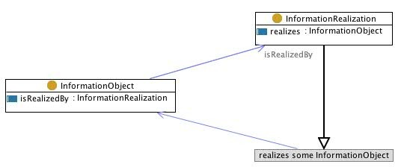
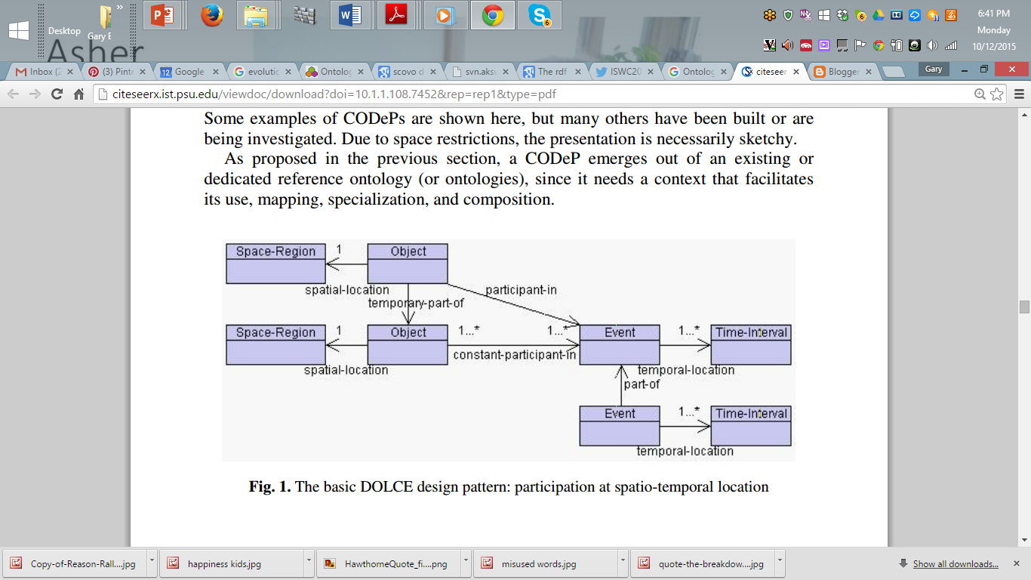
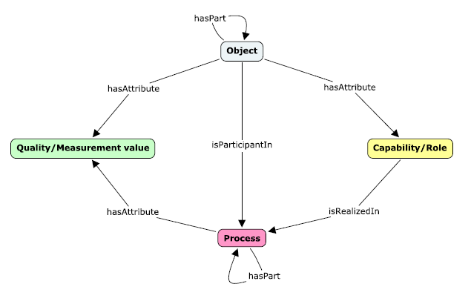
There are relevant ontology design patterns to consider

